Slide 1

Entertainer Data
Analysis
TABLEAU | PANDAS | EXCEL

Slide 2
Introduction
Overview :
The Entertainer Data Analysis project focuses on understanding the patterns and trends in the careers of entertainers. The dataset includes a comprehensive set of information about various entertainers, such as their birth year, the year they had their major career breakthrough, and the year they received their first major award. This analysis aims to uncover insights into how these factors interrelate and influence the career trajectories of entertainers.
Objectives :
The main objective of the analysis is to identify patterns and trends in the timelines of entertainer’s careers. Specifically, the analysis focuses on three critical aspects :
1
Birth Year : Understanding the age demographics of entertainers.
Break through Year : Identifying when entertainers typically achieve their first significant success.
2
3
Major Award Year : Analyzing the timeline of when entertainers receive major awards relative to their career milestones.

Slide 3
Problem statement
Normal life can be stressful and people need to relax. Being entertained by others is a wonderful way to take some time out of life. It can reduce stress and make life’s issues easier to face. The media and entertainment industry consists of film, television, radio and print. These segments include movies, TV shows, radio shows, news, music, newspapers, magazines and books. Entertainment industry is a group of sub-industries devoted to entertainment. Entertainment industry is used to describe the mass media companies that control the distribution and manufacture of mass media entertainment.

Slide 4
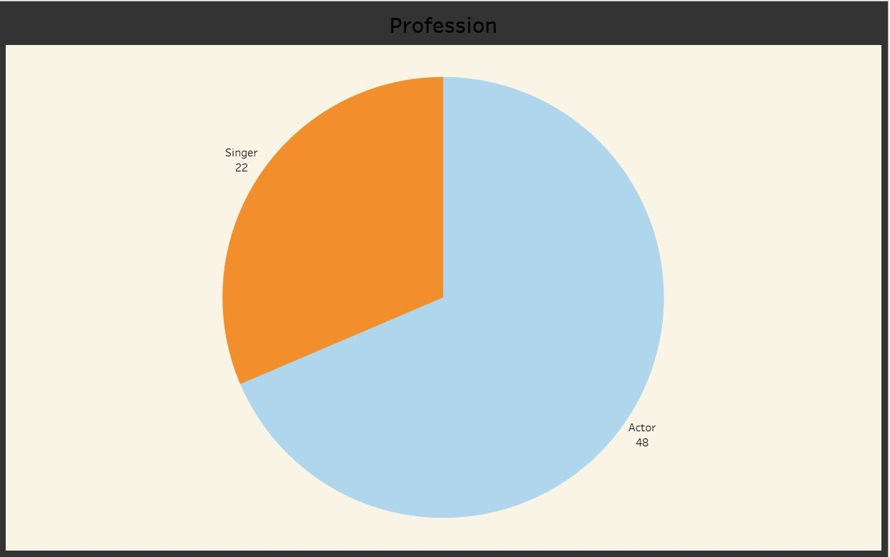
Visuals
Distribution of entertainers into their respective categories.
Pop stars, dancers, rockstars are added into singers.
Hosts and TV actors are divided into actors.
Some allrounders (actors + singers ) are added according to their main passion.

Slide 5
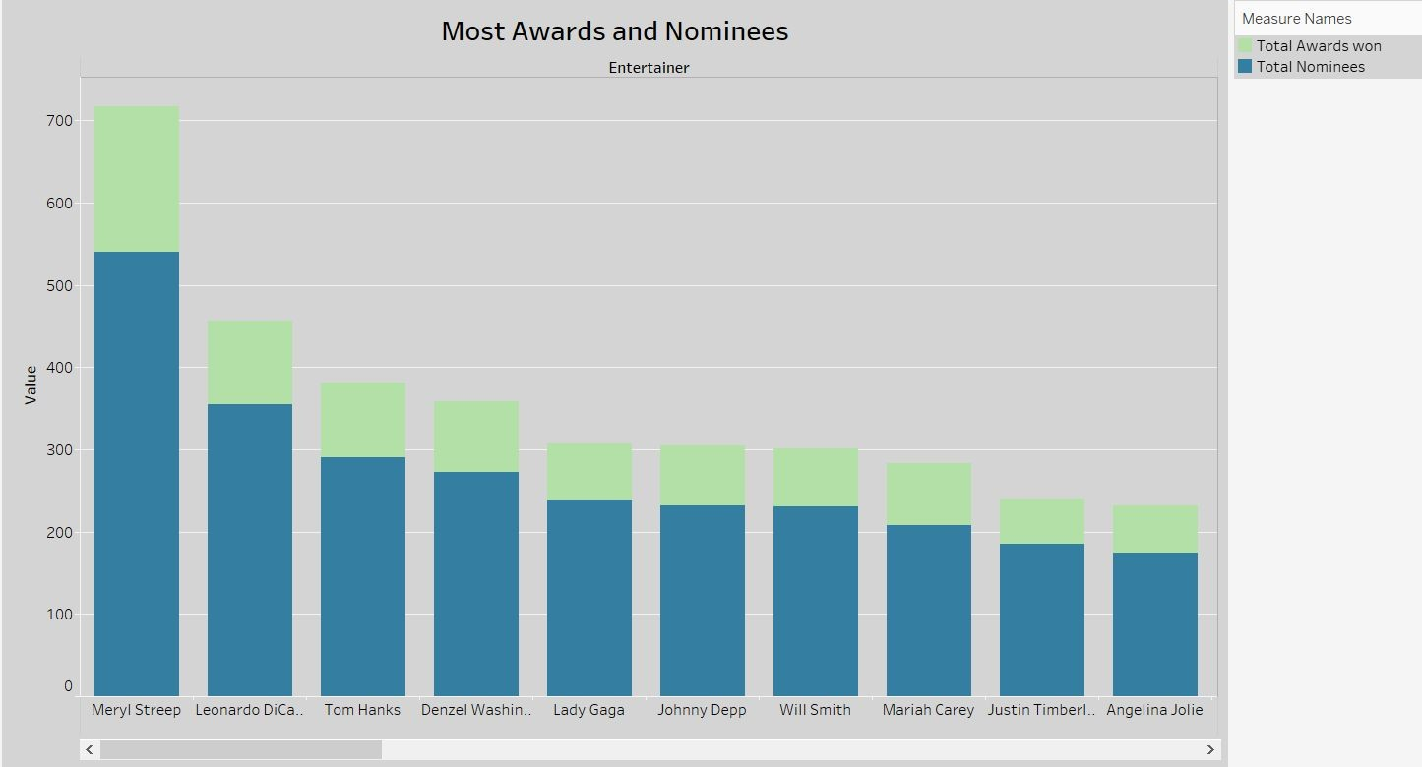
Most Awards and Nominees
Most number of awards with most nominees.
The green bar shows the total awards won and blue bar shows the total nominees.

Slide 6
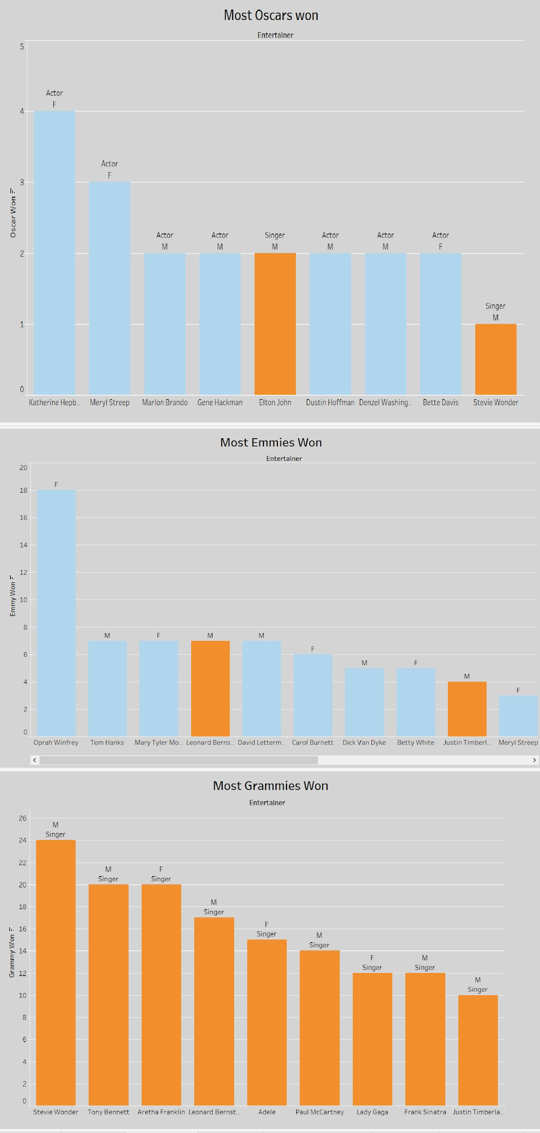
Most Oscars Won
Most Emmys Won
Most Grammys Won

Slide 7
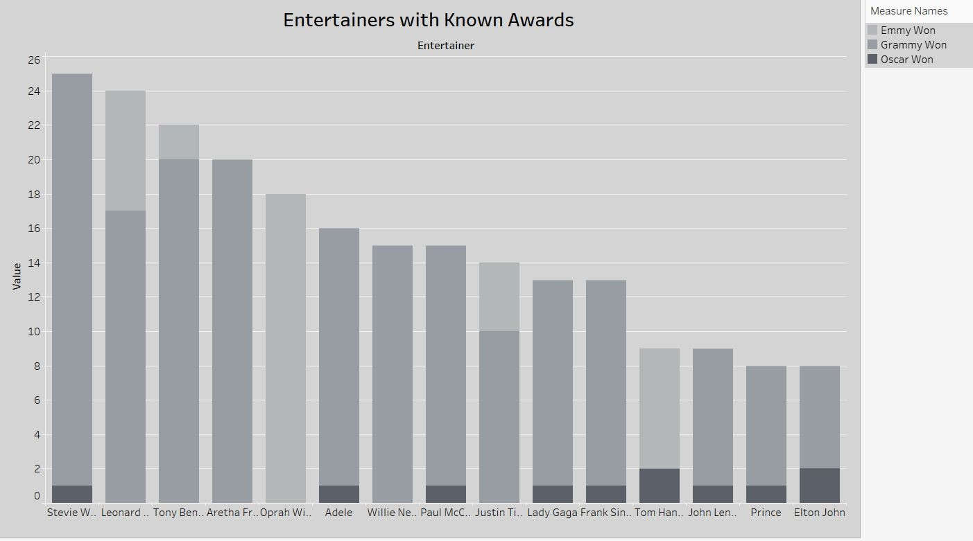
Visuals
Entertainers who won the mega awards.
Dark Grey shows the Oscars won count, Grey shows the Grammy won count and light Grey shows the Emmy won count.

Slide 8
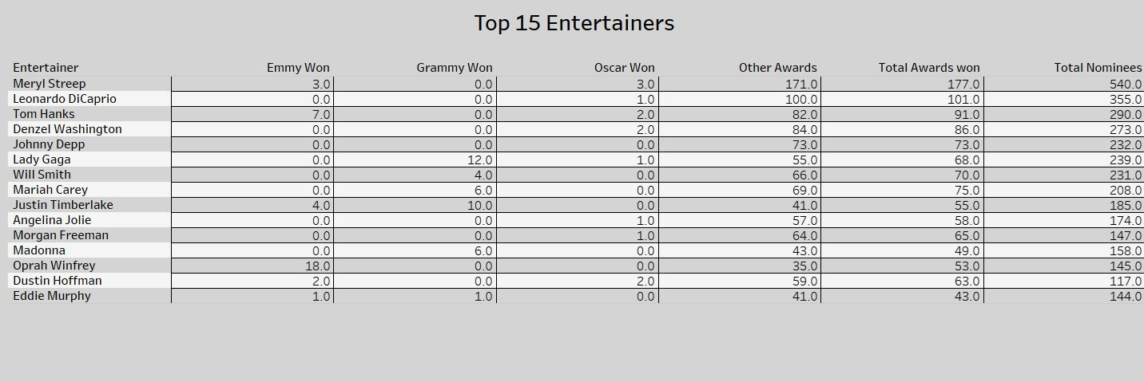
Visuals
Top 15 Entertainers

Slide 9
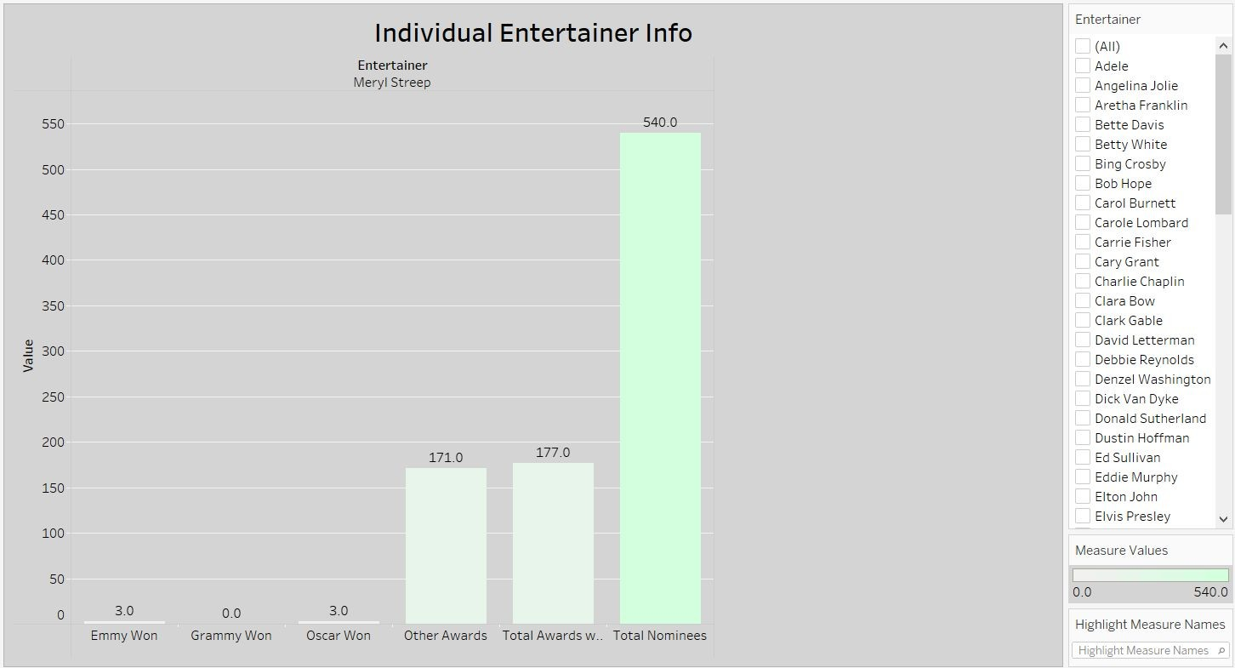
Visuals
This Graph shows the data according to the filters provided and changes according to the each entertainer. It is the Individual data analysis.

Slide 10
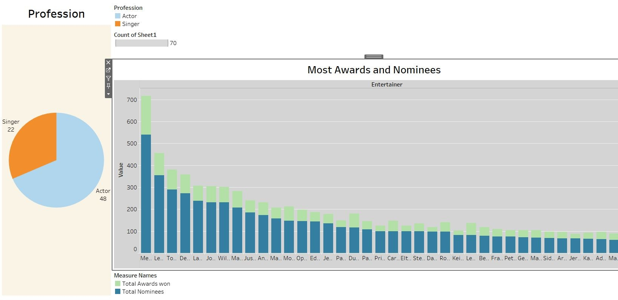
Dashboard 1

Slide 11
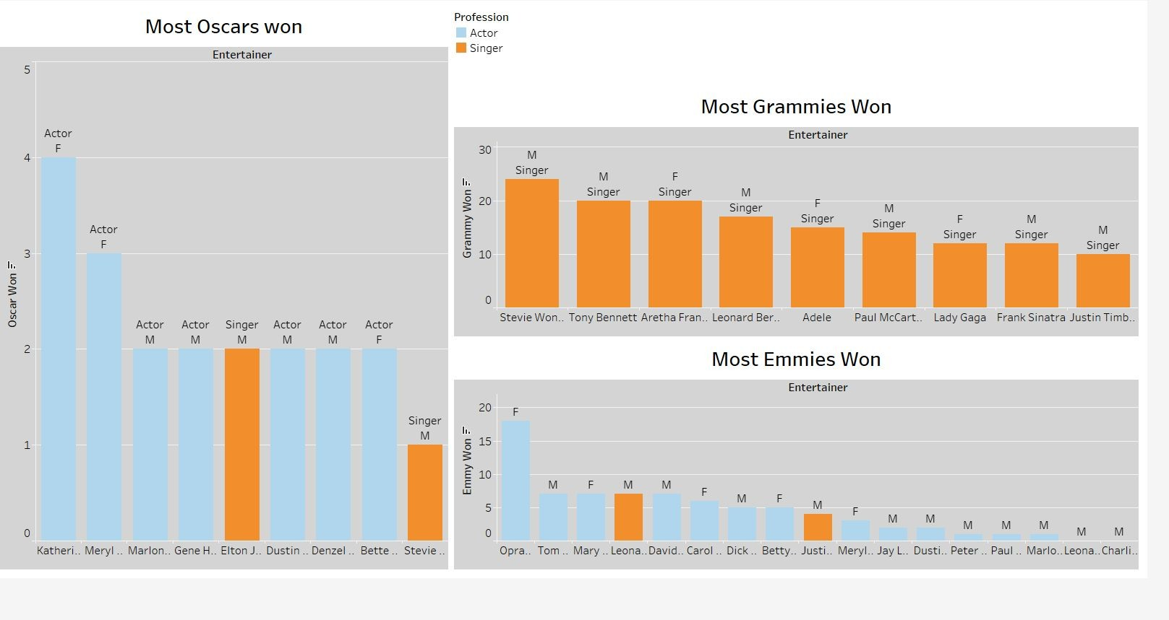
Dashboard 2

Slide 12
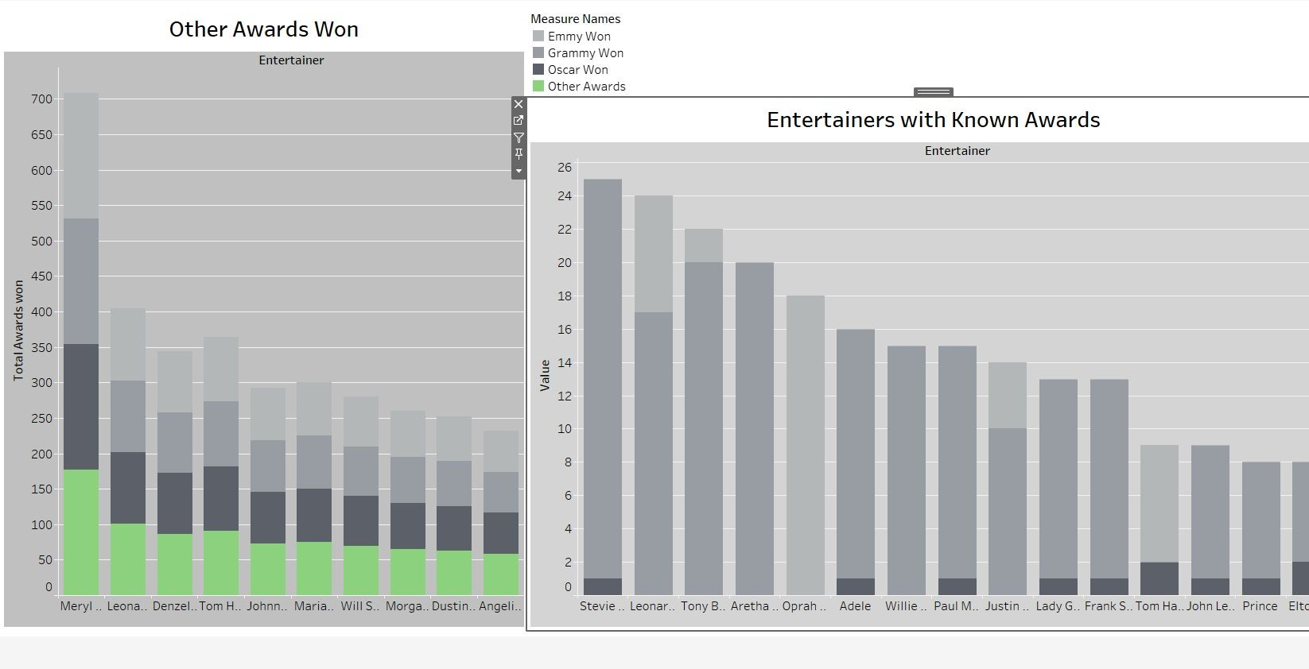
Dashboard 3

Slide 13
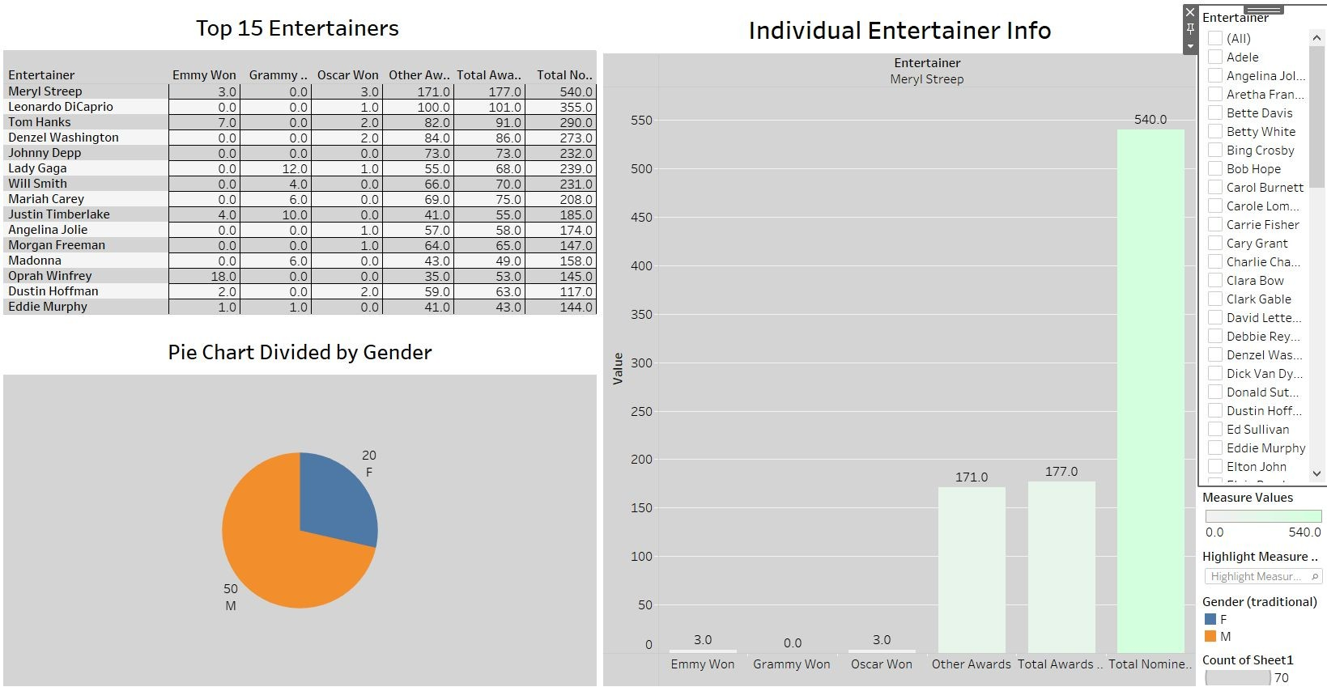
Dashboard 4

Slide 14
Thank you !
Bradly John

